Slide 1

CookConnect:A Recipe Sharing Application
Presented by:
Diya Khandelwal, R2142210293, DevOps
Akshay Mohpal, R2142210078, DevOps
Gaurav Bhandari, R21422210311, DevOps
Kanishka, R2142210393, DevOps
Under the guidance of:
Mr Sandeep Pratap Singh
School of Computer Science

Slide 2
Introduction
In a world driven by digital connectivity and a shared love of culinary delights, recipe-sharing apps have arisen as a game-changing tool for foodies to connect, create, and celebrate the art of cooking.
These platforms' overall success is attributed to its seamless navigation, visually appealing interfaces, and ability to seamlessly engage with other users.
This synopsis will delve into the project's core elements, exploring data representation, algorithmic implementation, real-time adaptability, and user interface design.

Slide 3
Problem Statement
Developing a robust and innovative recipe-sharing application that focuses on community building, user-friendly interfaces, seamless recipe sharing, enhanced social interactions, and user empowerment. The goal is to build a dynamic digital platform that not only acts as a repository for cooking creativity, but also fosters a vibrant global community of food enthusiasts by providing them with the tools and services they need to connect, share, and empower one another on their cooking adventures.

Slide 4
Objectives
User Authentication with Passport.js: Implement user registration and login using Passport.js authentication.
Deployment with Amazon EKS: Containerize your application with Docker to ensure consistency and portability.
Recipe Management and Search Functions: Allow users to create, amend, and remove recipes using a sophisticated text editor.
Favorite List and User Profile: Create a feature that allows users to add recipes to their favorites list.

Slide 5
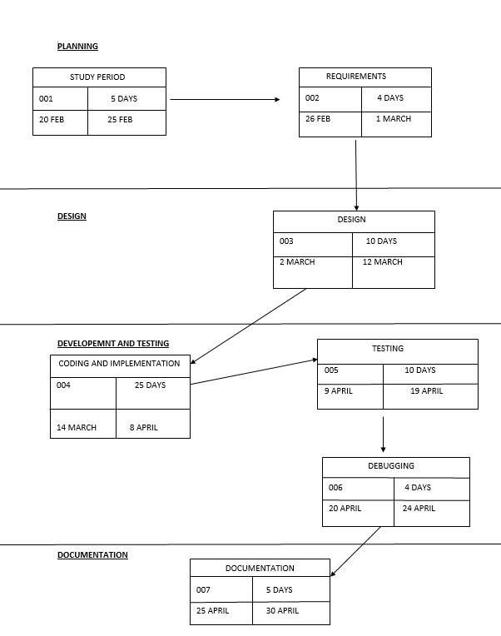
Pert Chart

Slide 6
Project Plan
Planning and preparation: Define categories, tags, and user roles for effective organization and accessibility.
Design of a user friendly model: Establish criteria for recipe discovery, including search relevance and personalized recommendations.
Algorithm Development for Allocation: Design a sophisticated recommendation algorithm tailored to recipe sharing.
Real-time Updates: Implement a real-time notification system to keep users informed about new recipes, comments, and activity.

Slide 7
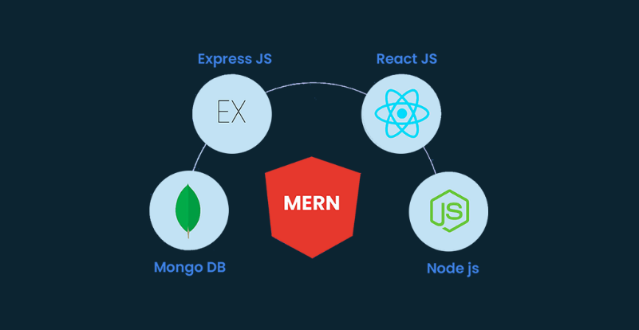
Tech Stack
Frontend:React js
Backend: node js and express js
Data base: Mongodb
Version control: Git

Slide 8
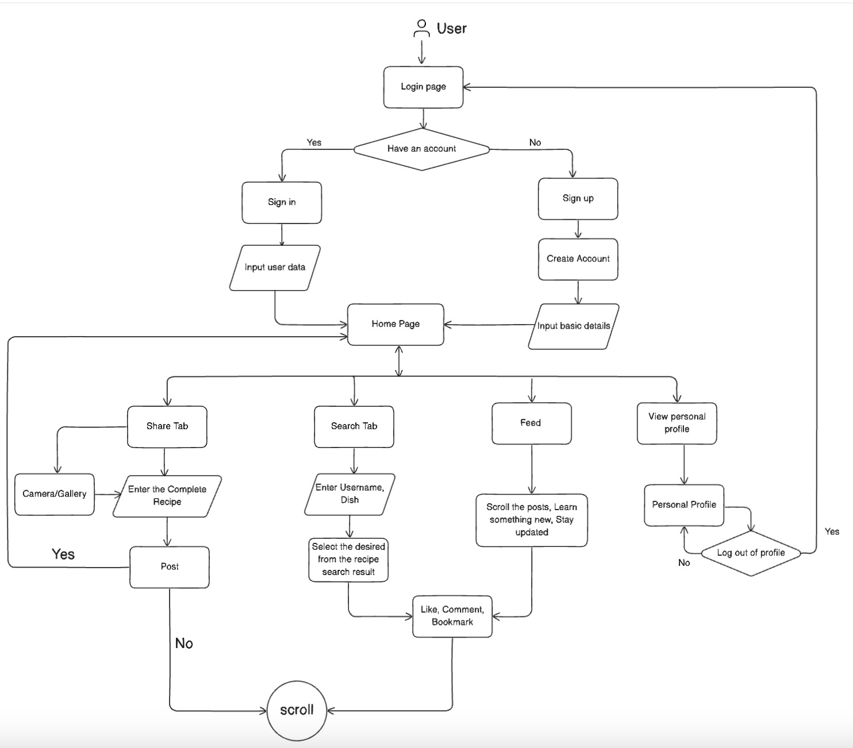
6.Proposed methodology

Slide 9
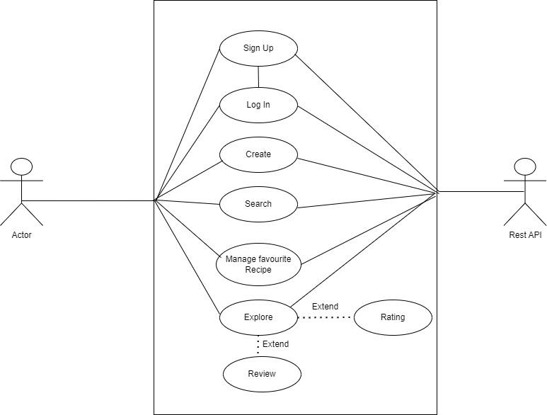
Use case Analysis

Slide 10
Code Summary
Below is a summary of the code structure for the Recipe Sharing App using the MERN (MongoDB, Express.js, React.js, and Node.js) stack:
Backend:- Node.js with Express.js
Frontend:- React.js
Database:- MongoDB

Slide 11
Frontend: Objectives Achieved
Sign up Page
Login Page
Landing Page
General Feed
Explore Page
Saved post view
Detailed Recipe Page
User Profile
Edit User Profile

Slide 12
Backend: Objectives Achieved
Authentication and Authorization
User Management
Recipe Management
Middleware and Error Handling
Testing
User Authentication Endpoints
Like and Save Functionality

Slide 13

Thank You

